Slide 1

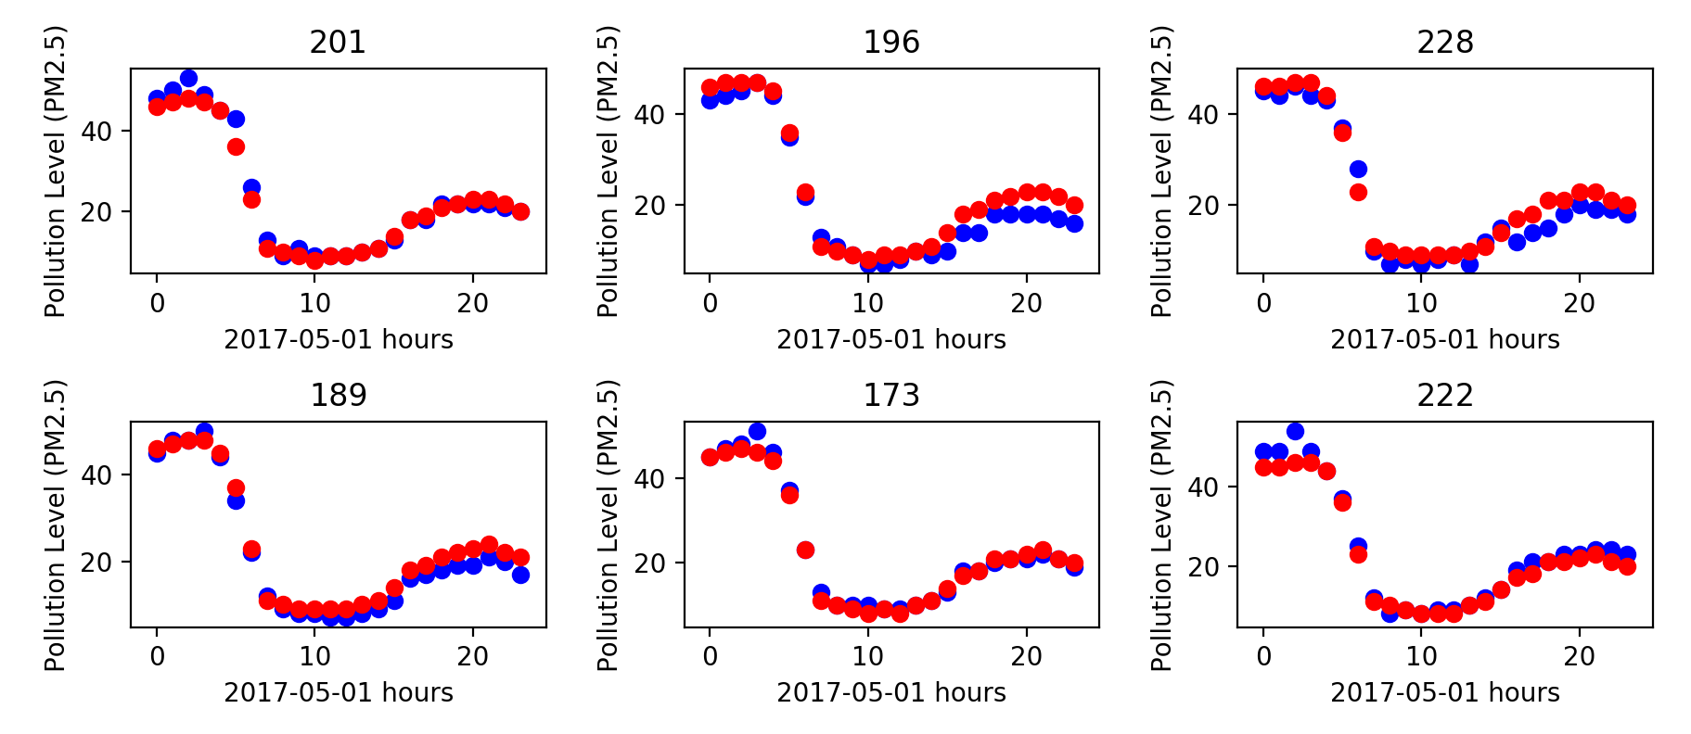
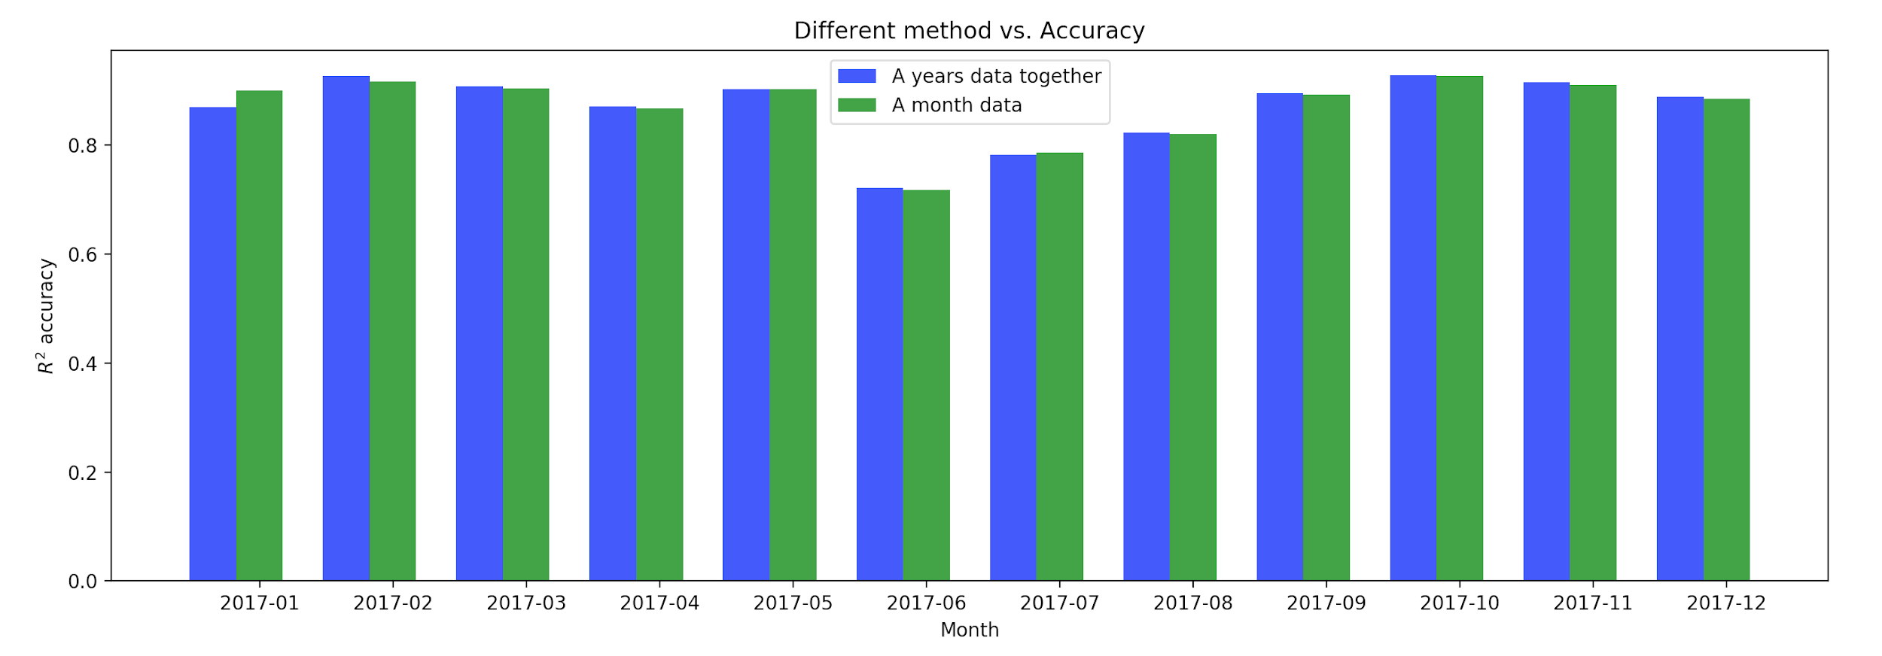
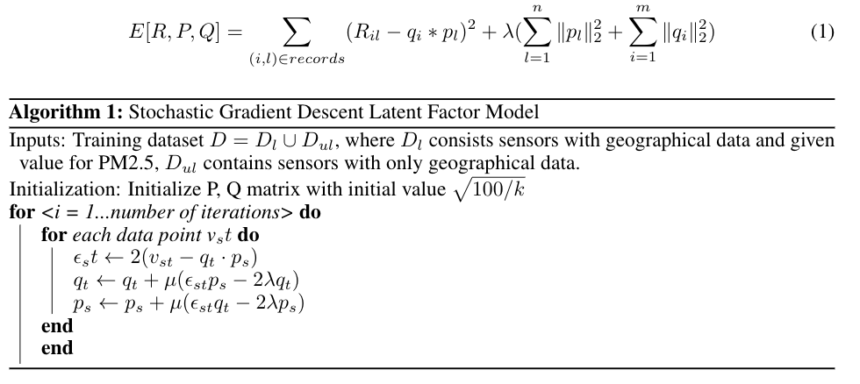
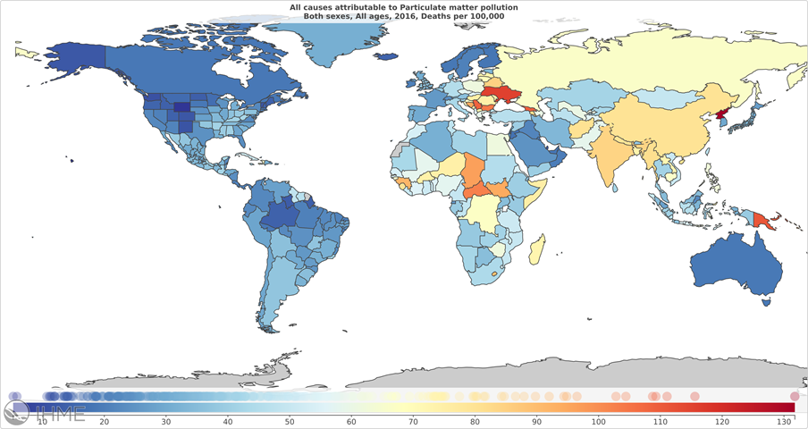
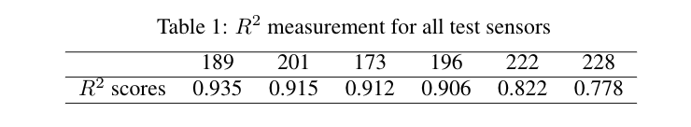
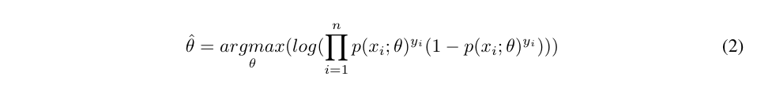
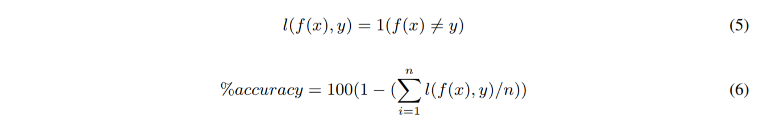
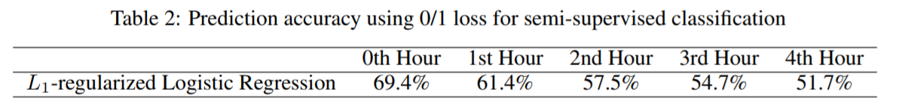
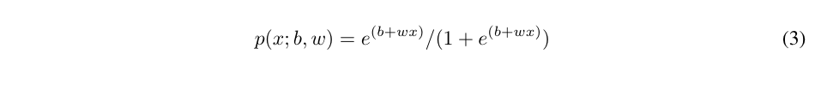
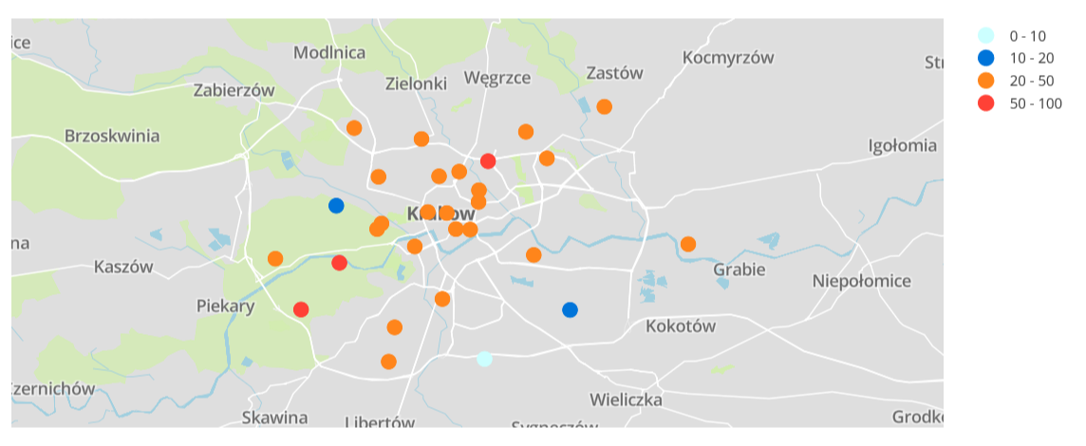
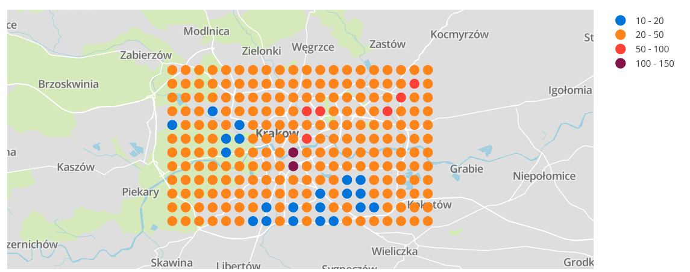
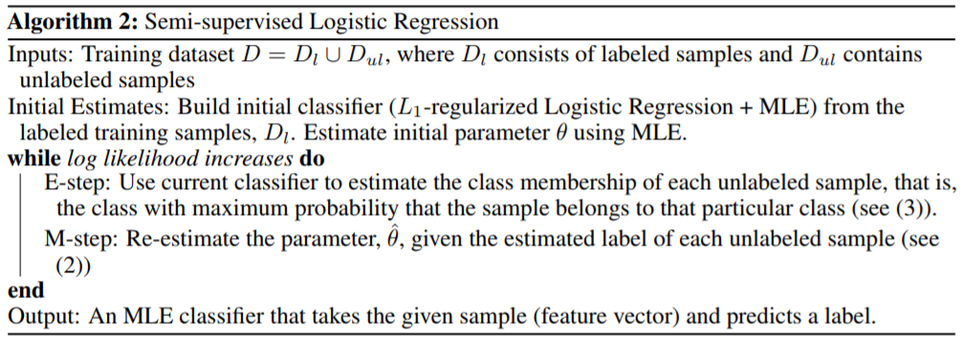
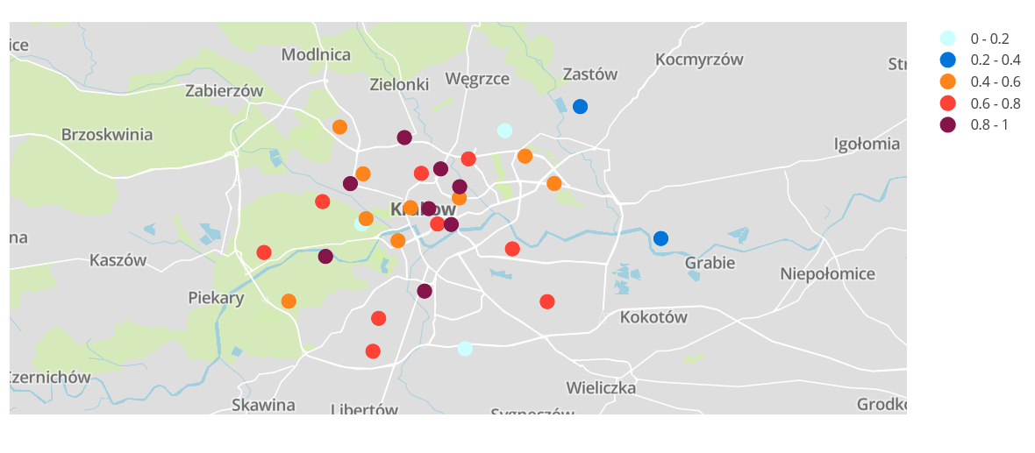
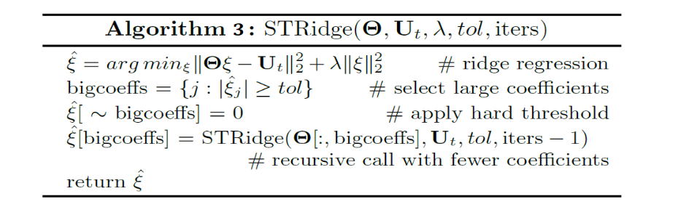
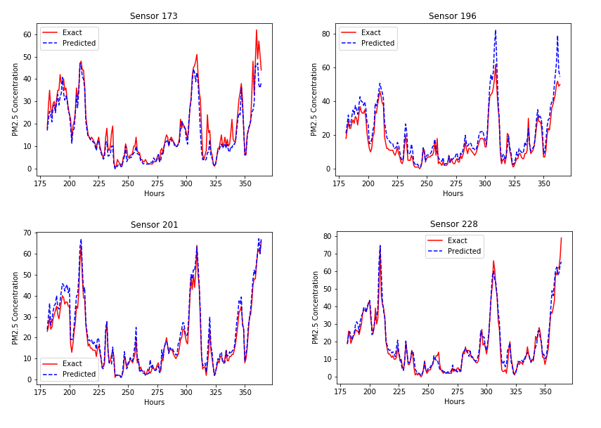
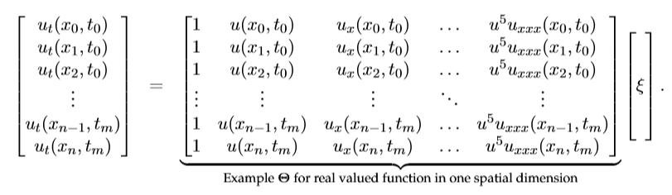
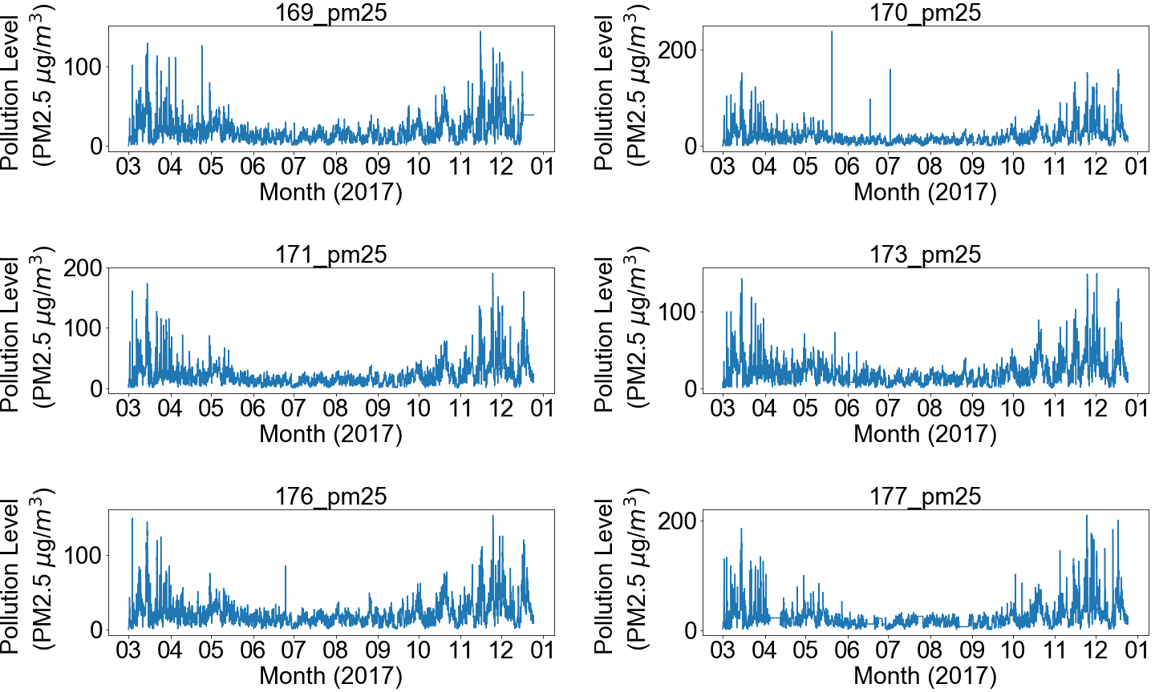
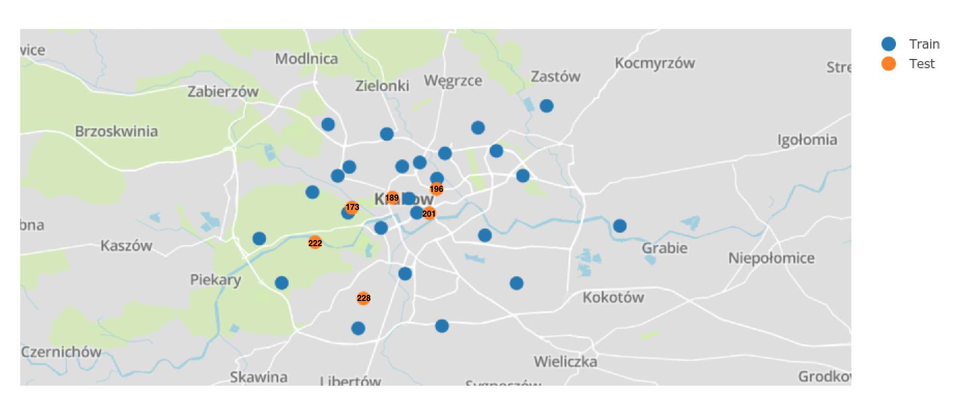


Air Pollution Mapping and Prediction
Gaurav Mahamuni¹, Mingyu Wang¹ and Su Ye²
¹Mechanical Engineering, University of Washington, ²Computer Science and Engineering, University of Washington
CSE 547: Machine Learning for Big Data
ABSTRACT
MODELS / ALGORITHMS
BELLKOR RECOMMENDATION RESULTS
Particulate Matter (PM) analysis is important in assessing an individual’s exposure to potentially harmful particles.
Currently, PM is recorded at sparse locations in a geographical area, however, the PM level can vary dramatically over small distances.
We map and predict PM levels at specific locations in the city of Krakow in Poland from spatio-temporal data of PM levels and meteorological data.
Bellkor recommendation system
Figure 5. Comparison of latent factor model results (red) vs true records (blue) .
Figure 6. Accuracy considering year vs month data.
This model can measure the overall trend with R²=0.928.
The model does not perform well for current time trend (best R² = 0.484).
The model is not suitable for prediction due to low accuracy which might be due to missing features in data.
Semi-supervised Classification using L₁-regularized Logistic Regression
SEMI-SUPERVISED LOGISTIC REGRESSION RESULTS
Figure 1. In the year 2016, ambient air pollution was responsible for 4.2 million deaths
DATA
We have two kinds of data in the dataset for each sensor: 1) Meteorological data: temperature, humidity and barometric pressure.
2) Air quality data: PM2.5, PM10 and PM1.
Figure 7. PM2.5 concentration labels for 7th March 6:00 AM at all 29 sensor locations (left) and PM2.5 concentrations mapped by semi-supervised L₁-regularized logistic regression model.
Data-Driven Discovery of Partial Differential Equations (PDE)
DATA DRIVEN DISCOVERY OF PDE
Prediction Based on Radial Basis Function Interpolation
Training data Matrix
Figure 2. Overall distribution of sensors and average normalized pollution at sensor locations for 10 months in 2017
Partial Differential Equation Generated By Algorithm 3
CONCLUSIONS
FUTURE WORK
Generating an algorithm that can accurately calculate the derivative of the interpolated data for data driven discovery of PDE.
Improving feature selection using different algorithms in semi-supervised classification.
Measurement of the PM level trend using Bellkor recommendation system achieved overall R² =0.928.
We classify PM concentrations into 6 classes using semi supervised L₁-regularized logistic regression. The model has 69.4% mapping accuracy and 61.5 % - 51.7 % prediction accuracy for 1 - 4 hrs.
ACKNOWLEDGMENTS
Figure 3. The relative position for test data with respective to all other training sensors
Figure 4. Pollution data over 10 months for 6 sensors. The pollution levels are higher in the fall and winter months.
This project was a part of CSE547 Machine Learning for Big Data Course. We thank Prof. Tim Althoff for his feedback.
Gaurav Mahamuni gauravsm@uw.edu Mingyu Wang myw518@uw.edu Su Ye yes23@uw.edu
Notes:
1

